Slide 1

Drug Consumption Rooms:
Service Models and Evidence
Thomas Kerr
Professor, Division of Social Medicine
Faculty of Medicine, University of British Columbia
Senior Research Scientist, BC Centre on Substance Use
Mary Clare Kennedy
Canada Research Chair in Substance Use Policy and Practice Research
Assistant Professor, School of Social Work, University of British Columbia - Okanagan
Research Scientist, British Columbia Centre on Substance Use

Slide 2
DCR Objectives
Reduce risk and consequences of non-fatal and fatal overdose
Reduce unsafe drug use practices and risk of infectious disease acquisition/transmission
Facilitate access to internal/external services and programs
Reduce public disorder

Slide 3
DCR Models
Stand-alone/Fixed DCRs
Integrated DCRs
Hospital-based DCRs
Housing-based DCRs
Mobile DCRs
Temporary emergency DCRs

Slide 4
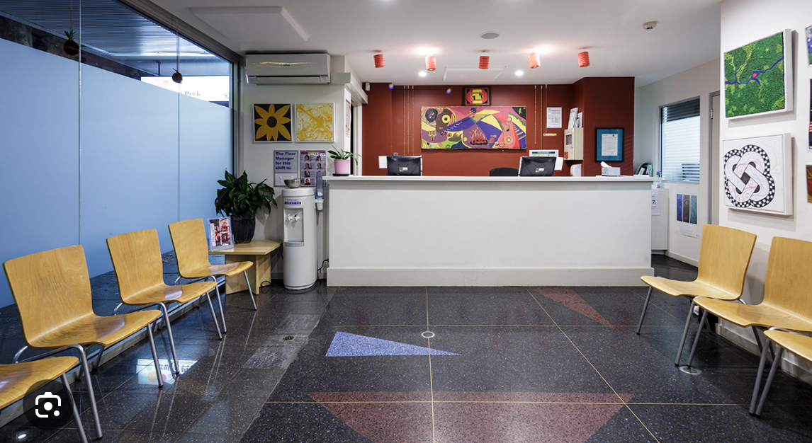
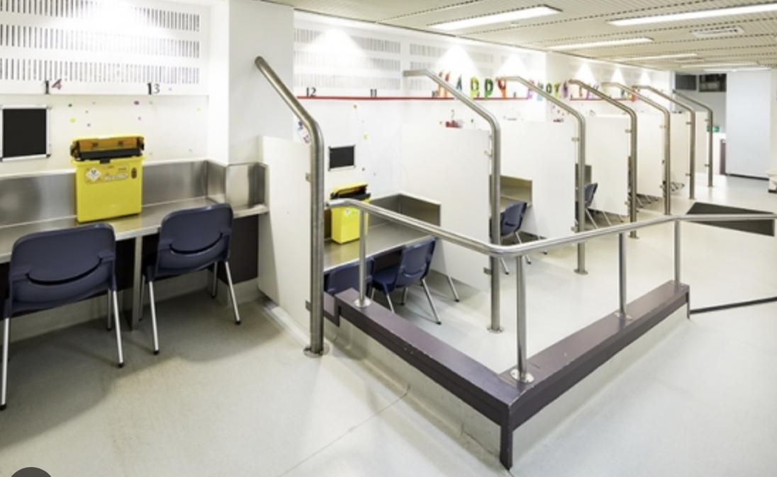
Stand
Stand-alone/Fixed DCRs
MSIC, Sydney, Australia

Slide 5
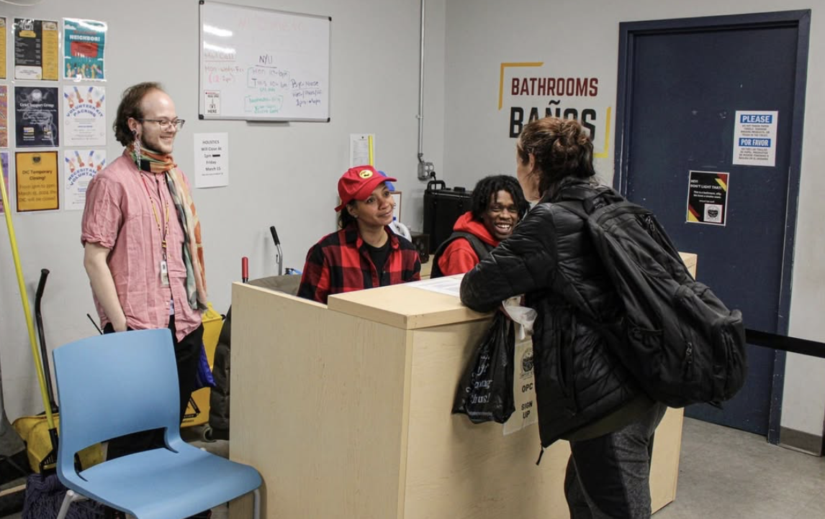
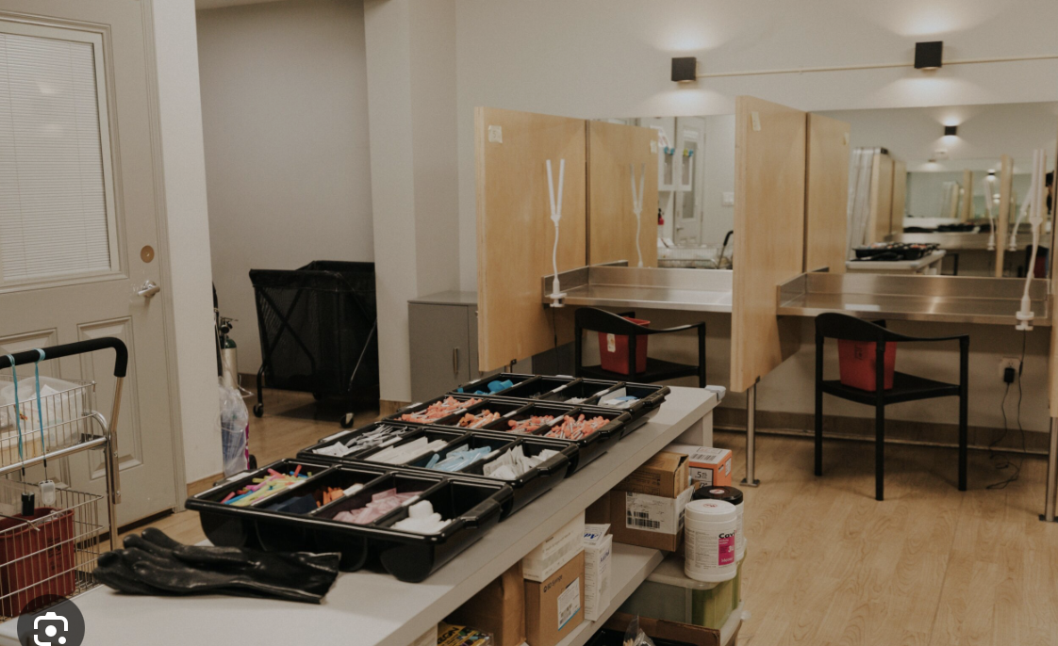
Stand
Integrated DCRs
On Point, New York, USA

Slide 6
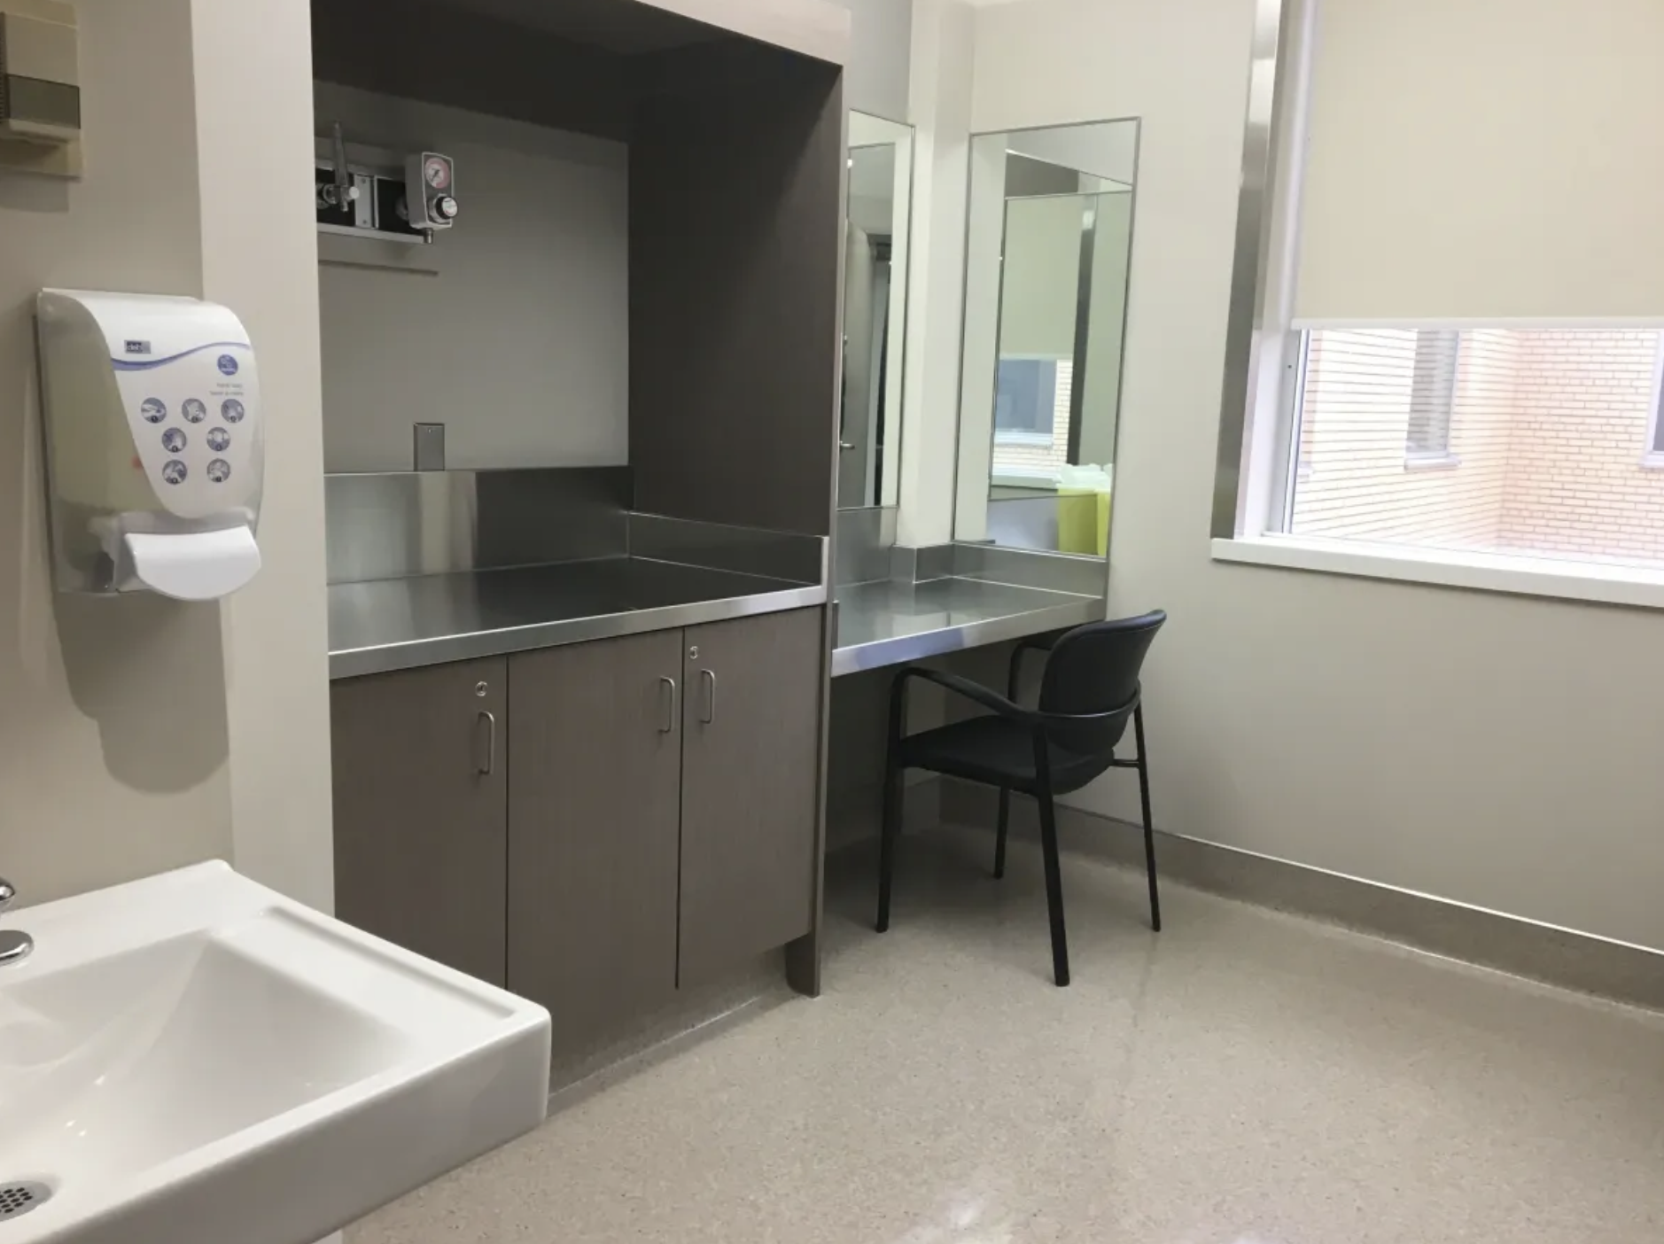
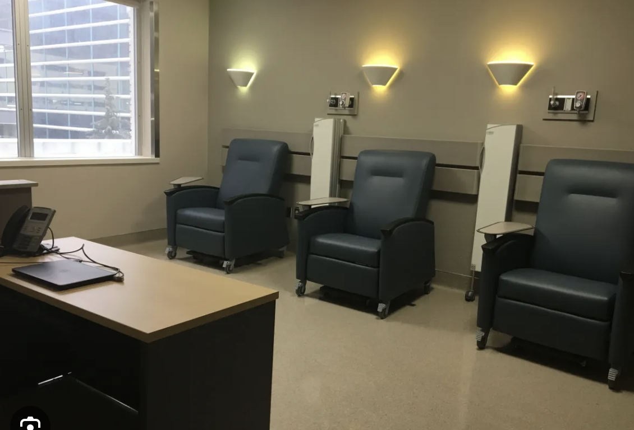
Stand DCR
Hospital-based DCRs
Royal Alexander Hospital , Edmonton, Canada

Slide 7
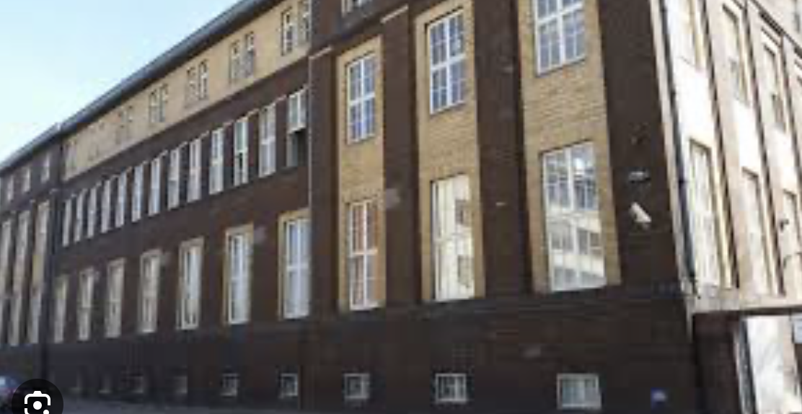
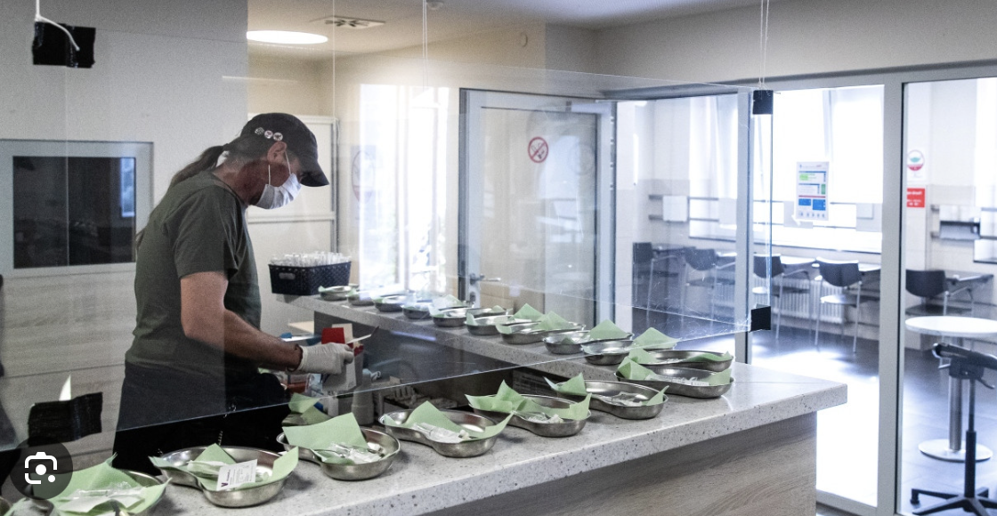
Stand
Housing-based DCRs
Eastside/idh – Integrative Drogenhilfe, Frankfurt, Germany

Slide 8
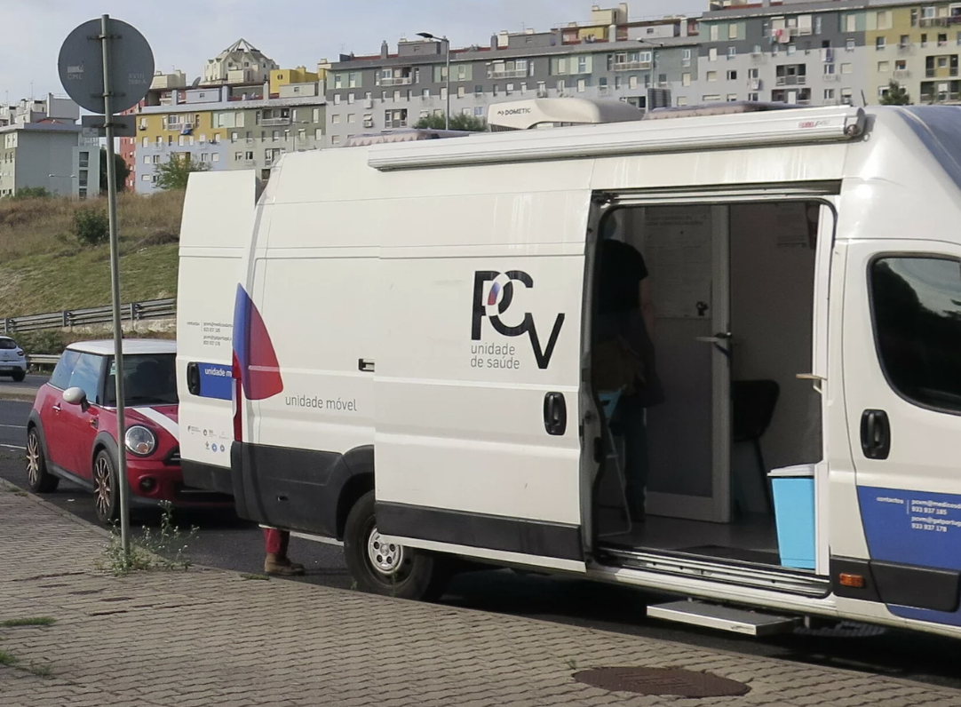
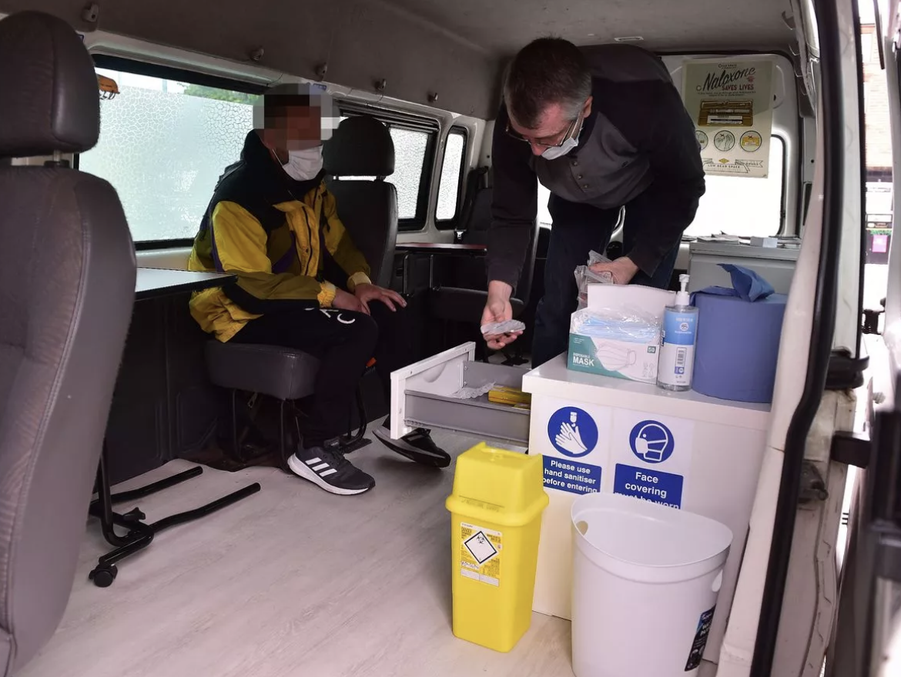
Stand DCCRS DCR
Mobile DCRs
Mobile DCR, Lisbon, Portugal
Safer Drug Consumption Van, Glasgow, Scotland

Slide 9
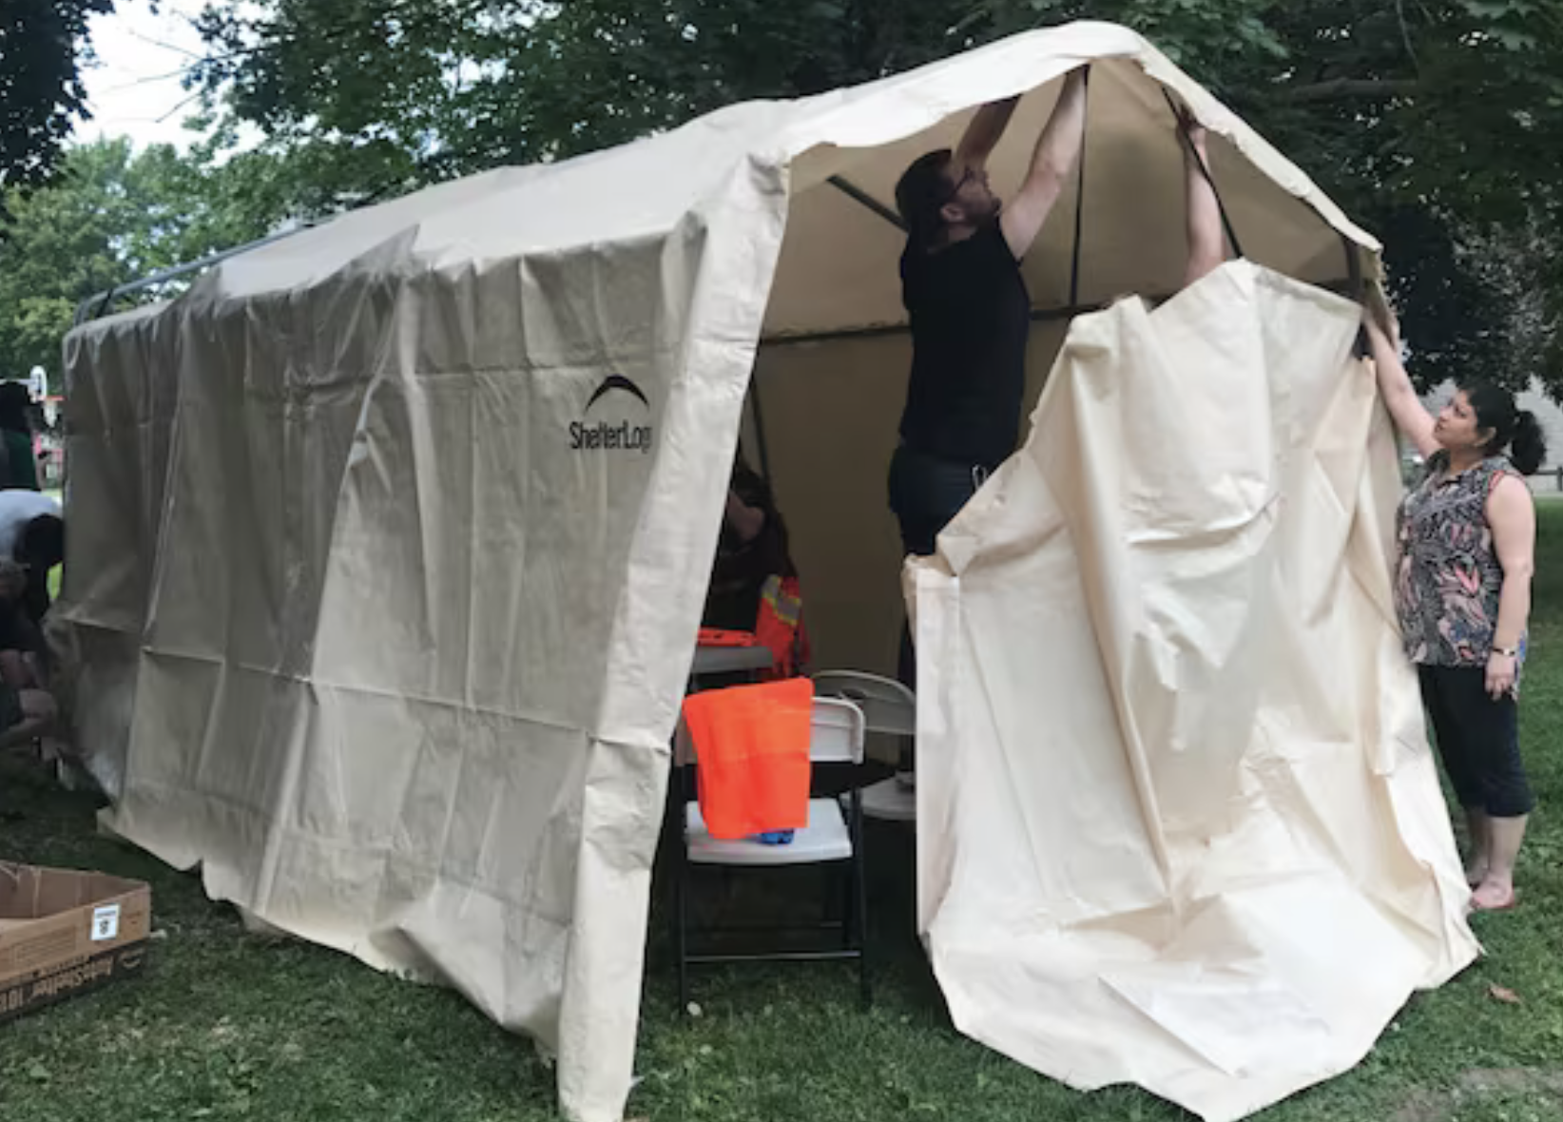
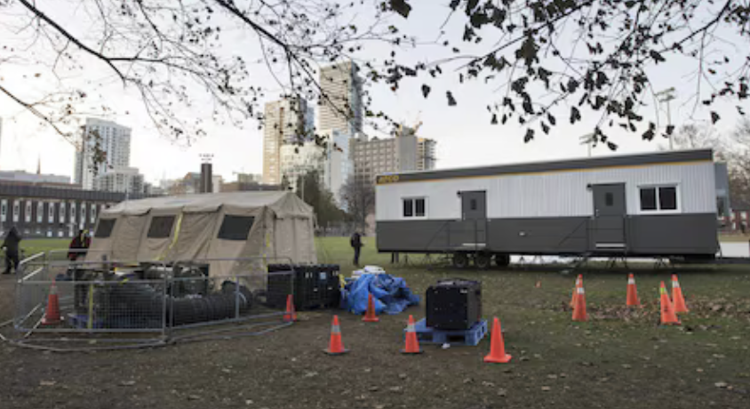
Stand
Emergency temporary DCRs
Moss Park Overdose Prevention Site, Toronto, Canada

Slide 10
The State of DCR Evidence
DCRs have been rigorously evaluated in a range of settings
Methods restricted to observational approaches (e.g., cohort studies), mathematical modelling, quasi-experimental approaches, and qualitative research
Unethical to conduct a randomized controlled trial

Slide 11
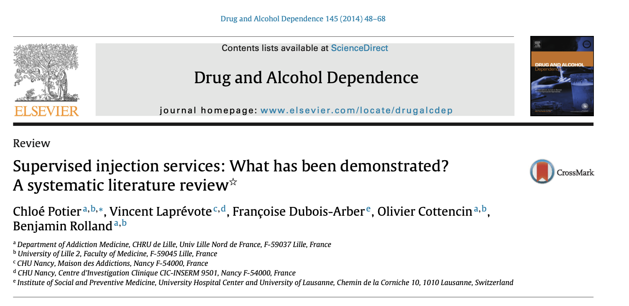
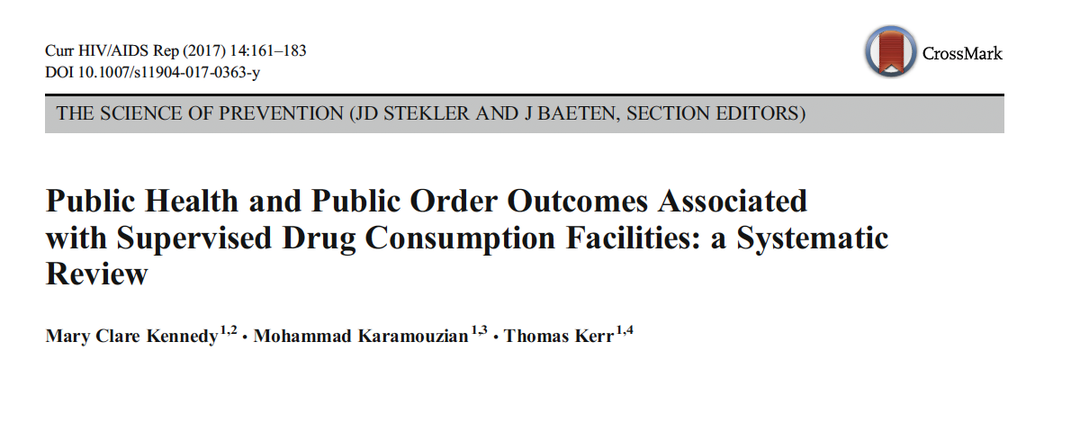
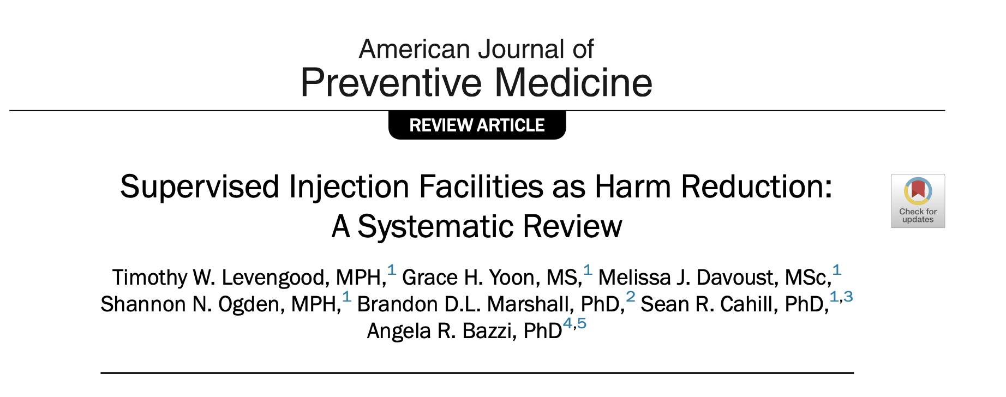

Slide 12
The state of DCR evidence
DCRs reduce overdose-related morbidity and mortality
DCRs support safer drug use practices
DCRs facilitate uptake of addiction treatment and other services
DCRs reduce public disorder concerns associated with drug use
DCRs are cost effective

Slide 13
What about unintended consequences?
A growing body of evidence indicates that DCRs do not exacerbate crime and public disorder and typically result in improvements in these domains
No evidence of prolonged substance use or delayed treatment entry
No impact on initiation into substance use

Slide 14
The State of DCR Evidence
RCTs of DCRs have been deemed both impractical and unethical
Some decision makers reluctant to endorse DCRs
The evidence concerning DCRs is consistent across a range of settings and service designs
Biological plausibility is high
Within grading systems that accommodate non-experimental evidence, DCRs can be regarded as evidence-based interventions capable of producing a range of benefits

