Slide 1
DCR-Cambie.
Corporación Acción Técnica Social – ATS
Daniel Rojas Estupiñan. Coordinator.

Slide 2
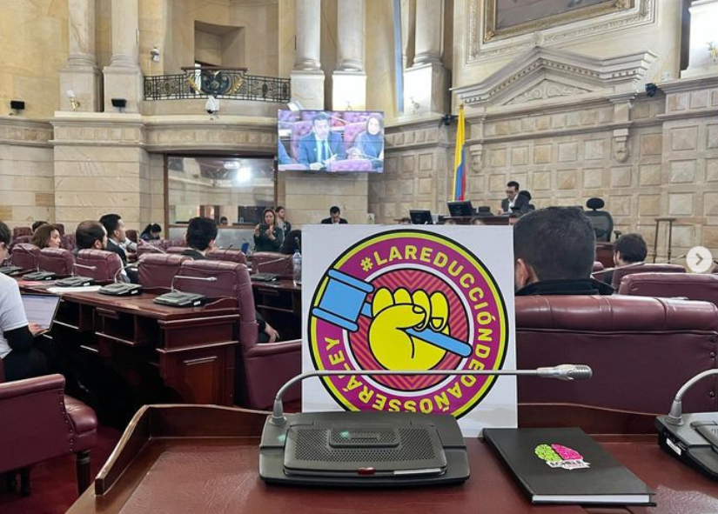
¿Who we are?
ATS is a non-profit organization with 15 years of experience in drug use intervention and drug policy reform in Colombia, seeking to promote the human rights of PWUD, from a harm reduction approach to improve health, quality of life, and well-being of individuals and the community.

Slide 3
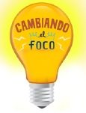
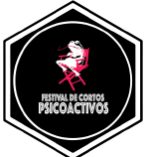
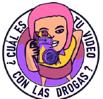
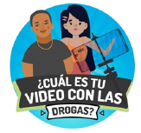
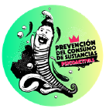
Main projects

Slide 4
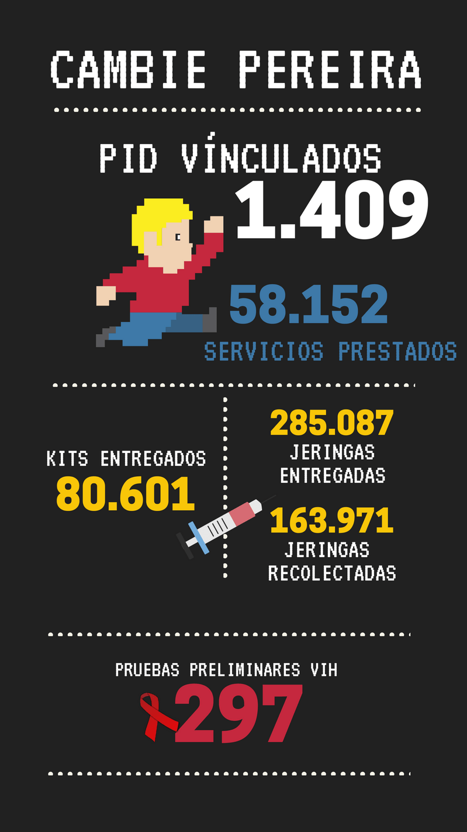
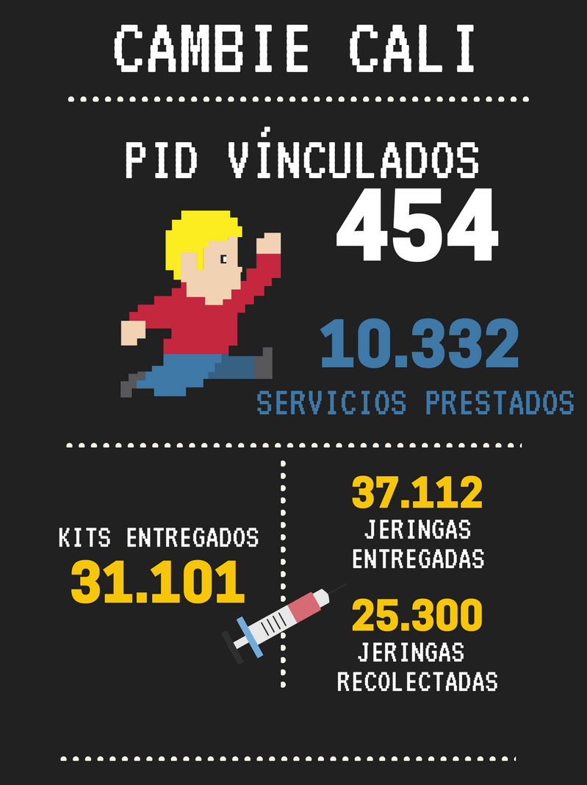
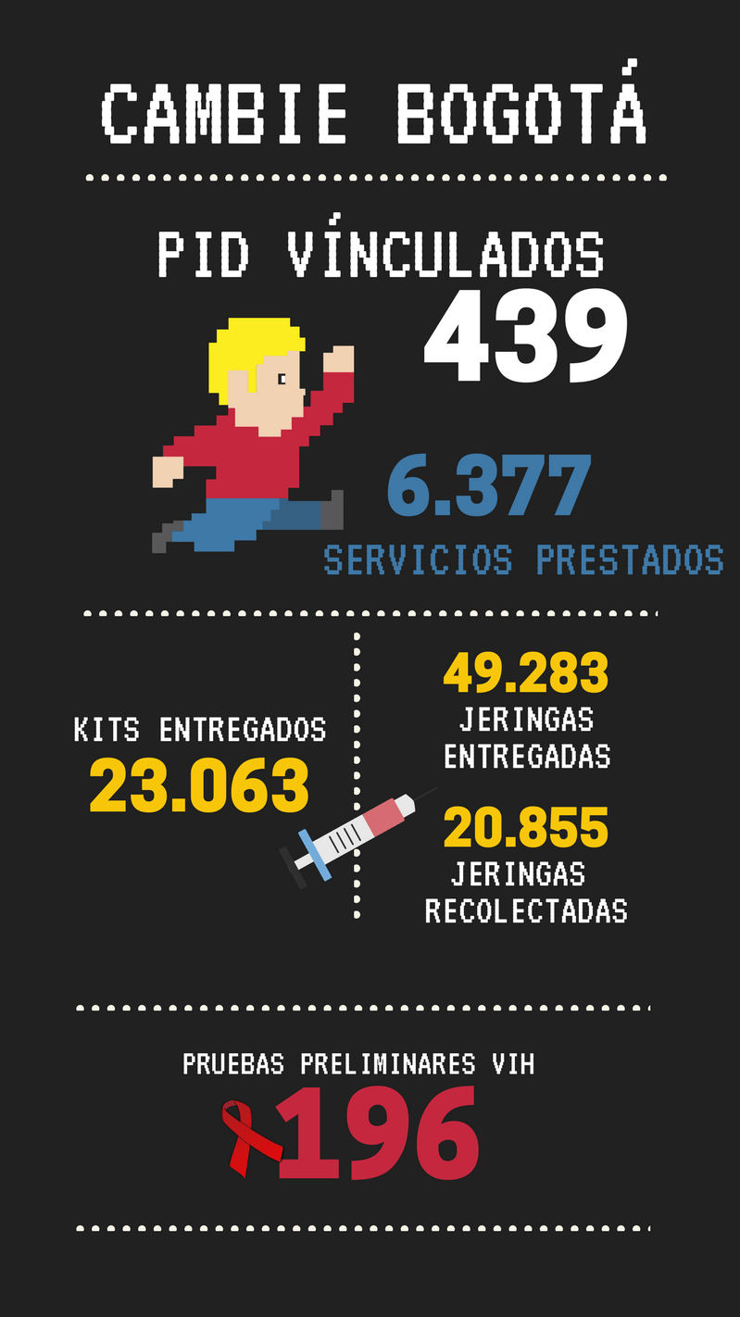
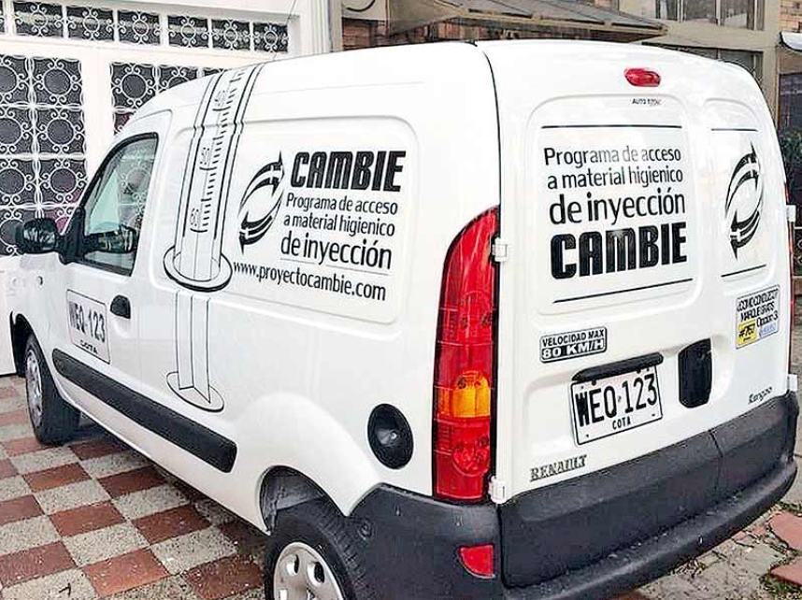
¿When started the Cambie program?
It began in 2014 as the first needle exchange program for PWID in Colombia, operating for almost 3 years in 6 cities or territories, mainly in Bogotá, Cali and Pereira-Dosquebradas. Some results were…
We helped create the naloxone guidelines in the community space.
We helped create the intervention guidelines for people who inject drugs.
Official guidelines of the government.

Slide 5
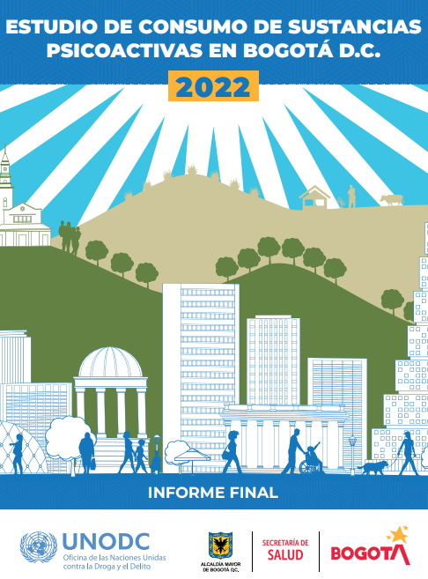
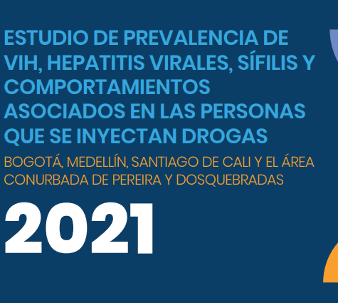
¿ Why did we do a SCS in Bogotá?
In Colombia, there is no official and reliable data on the number of people who have died from overdoses. And there is a structural invisibility in relation to the phenomenon of injectable drug use, especially heroin.
We need updated data. All of our substance use reports were made more than 4 years ago or have a wrong information.
The country does not have regulations that govern safe consumption spaces, and the process since the emergence of the current drug policy may take years.
Users are exposed to unhygienic environments, access barriers, overdoses, vulnerabilities and a lot of violence.

Slide 6
Implementation challenges
Institutional or legal.
Lack of regulations, ignorance accompanied by fear and stigma, denomination of Cambie, advertising and location.
Community.
Resistance and NIMBY effect, stigma with violent narratives towards users.
Users.
Low confidence at the beginning, difficulty in adherence, waves of violence focused on heroin users.
Infraestructure.
Finding a location close to the dynamics of the users, remodeling the entire space and adapting it according to particularities and resources.

Slide 7
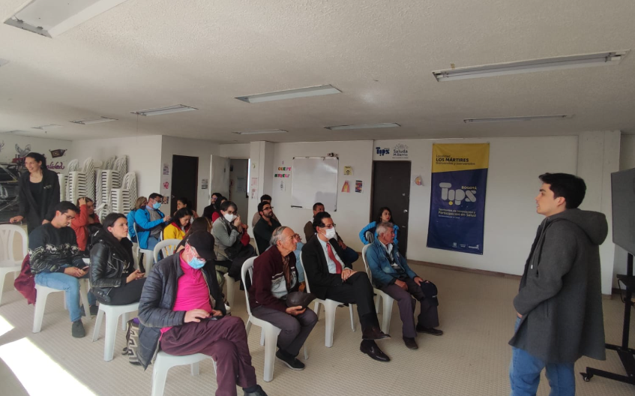
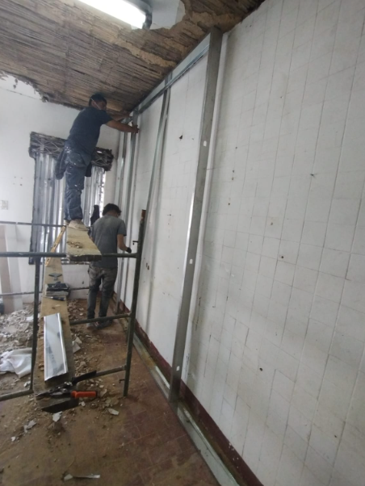
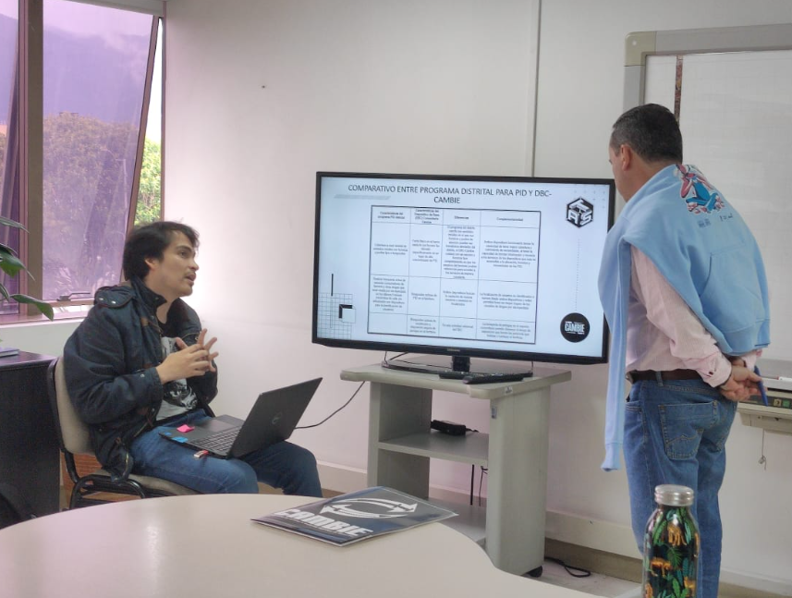
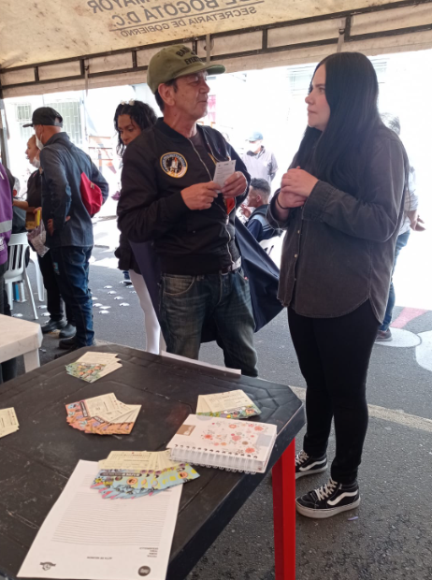
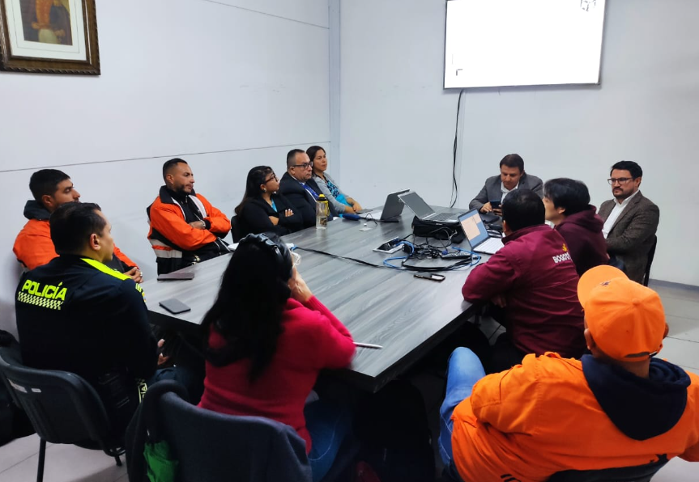

Slide 8
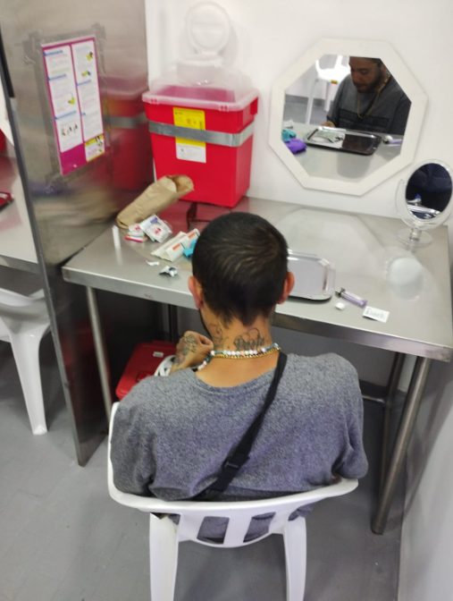
Cambie and our services.
First and foremost, it is a comprehensive community care program for people who inject drugs. Our model and operation is peer-based. It is based on the SCS in Vancouver and organizations such as PrevenCasa and Verter in Mexico. It is the first SCS in Colombia and South America.
Services:
Low-risk consumption space, accompanied by information and harm reduction guidance.
Overdose response protocol inside and outside the facility.
Hygienic injection material.
Education, training and provision of naloxone to users or support networks.
Referral for HIV and hepatitis testing.
Active search for used syringes in the community space.
Safe disposal point for used syringes.

Slide 9
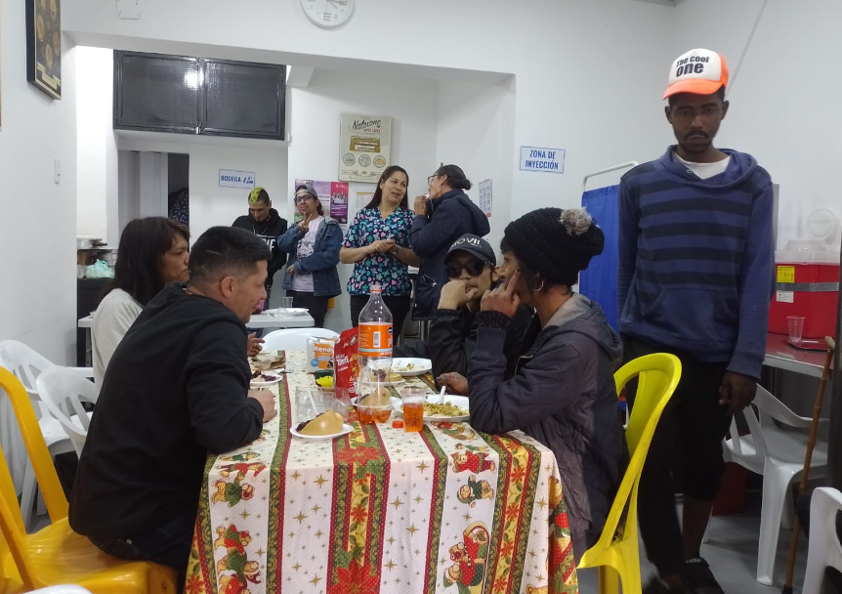
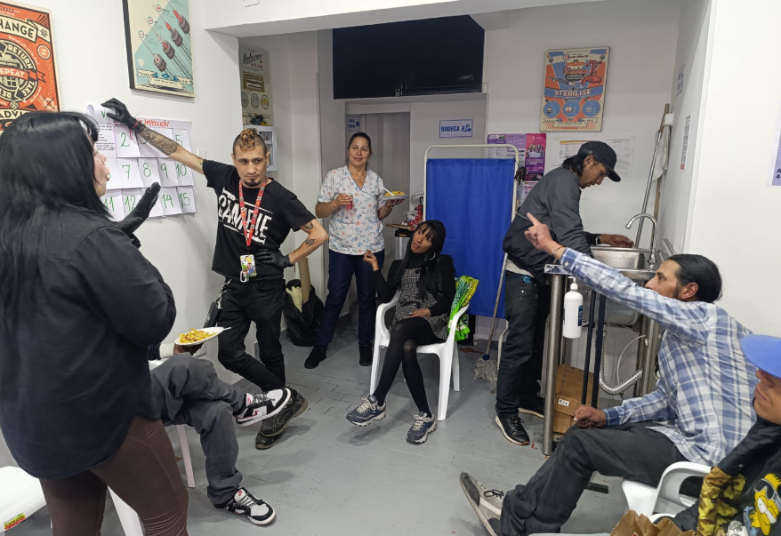
Services…
Psychological and social work counseling.
Hot food and drinks.
Wound healing.
Referral to other social-health services (emergencies, detoxification, rehabilitation).
Management of access barriers for medications (e.g. methadone) or other basic services.
Articulation with other services and institutions to cover basic needs (e.g. showers, housing).
Any need we identify will be sought to address.

Slide 10
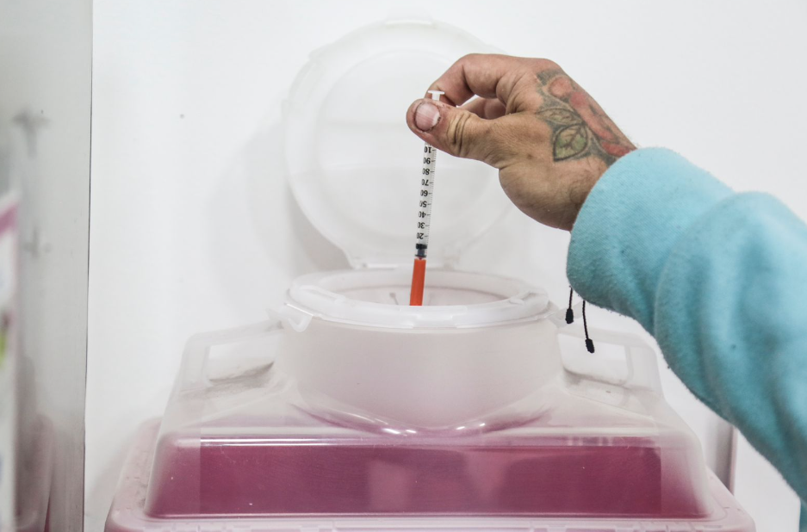
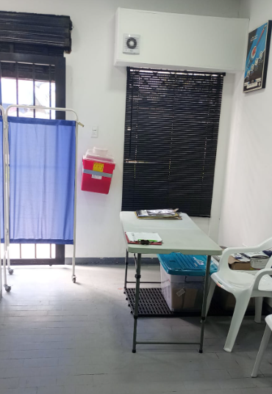
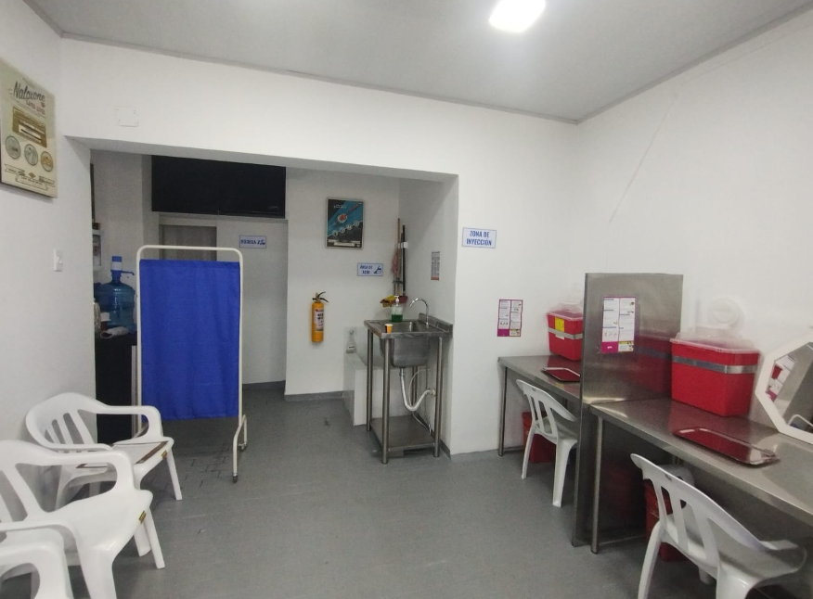

Slide 11
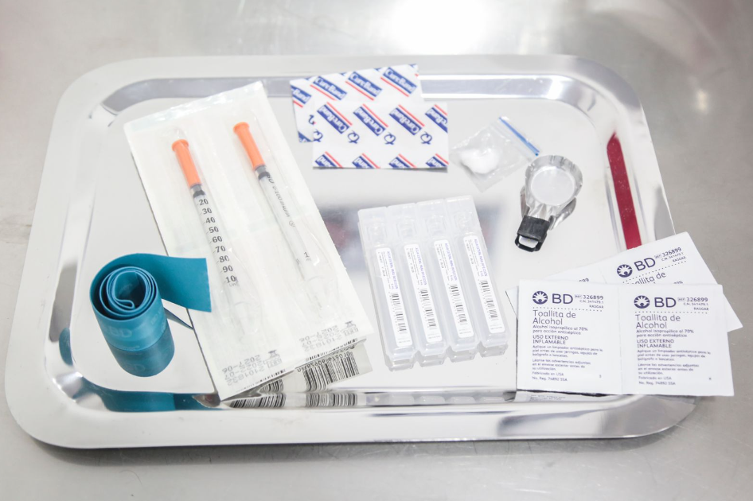
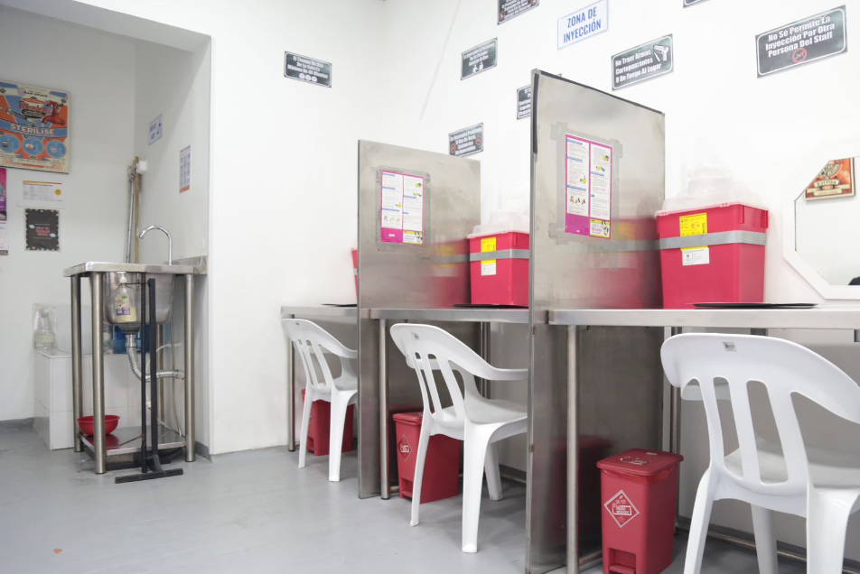
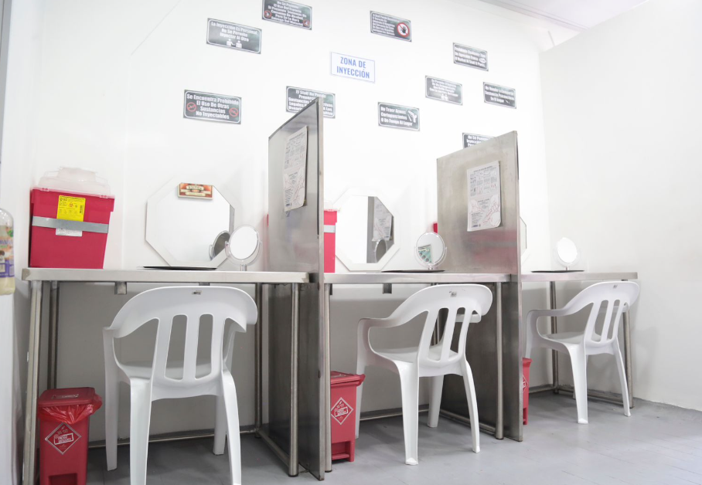
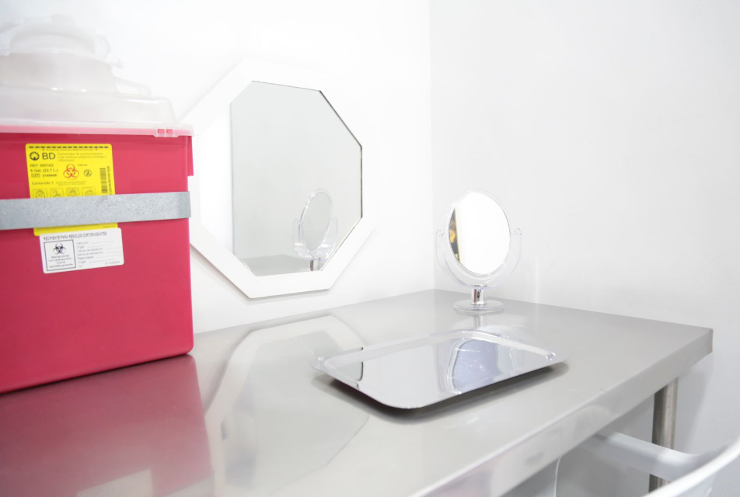

Slide 12
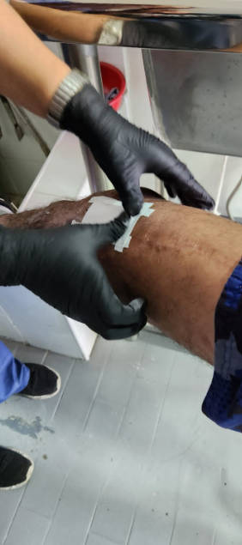
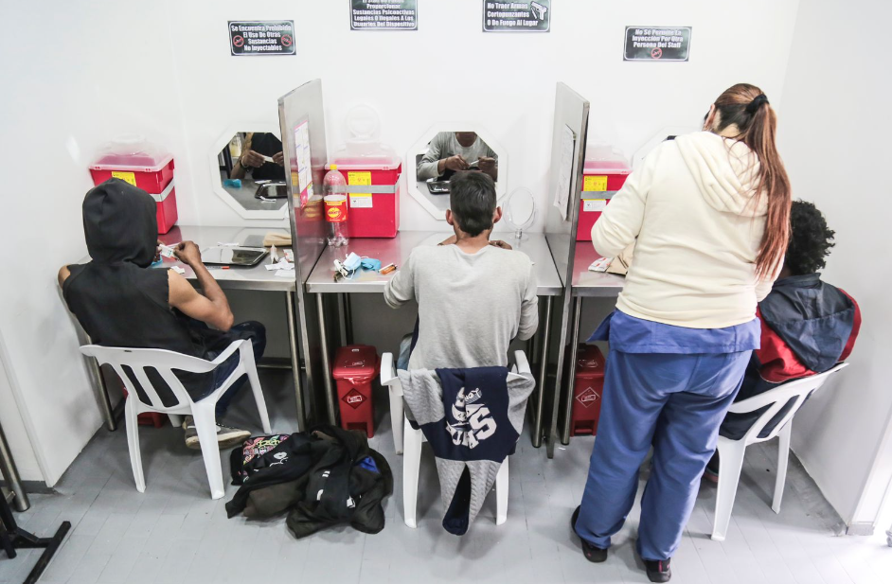
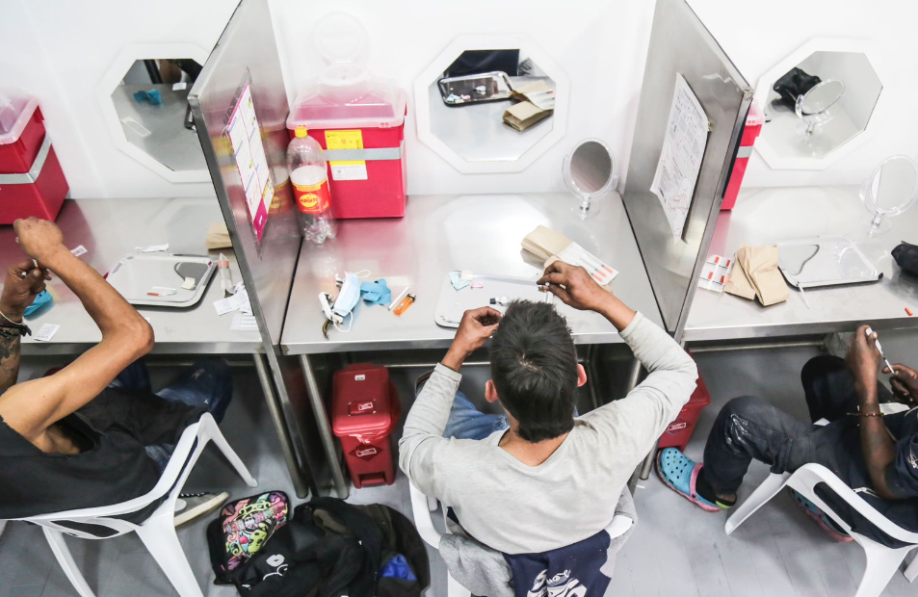

Slide 13
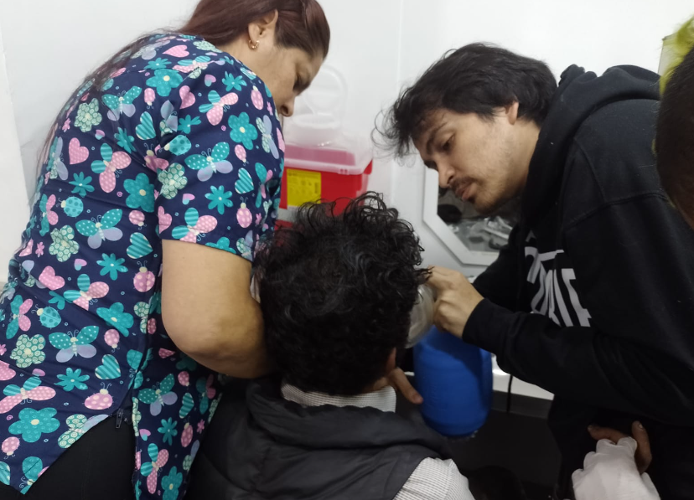
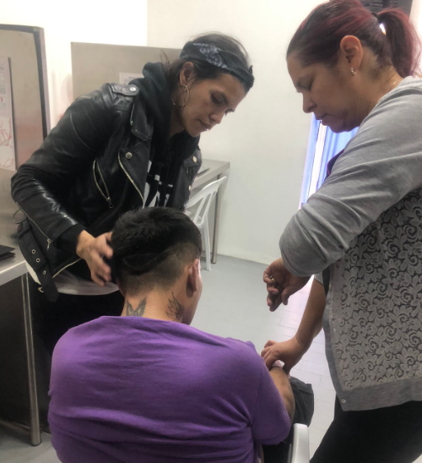
Results.
the space has been used 2477 times.
14 overdoses reversed (4 outside the facility), the last overdose was 11 months ago.
Main substance used:
- Heroín
- Speedball
- Cocaine
Otras: Ketamine y meth
+45,450 sterile syringes have been given.
+15,639 used syringes have been collected between presence in public spaces and user returns.
+11,362 injection hygiene material kits have been provided.

Slide 14
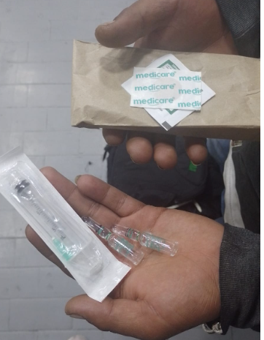
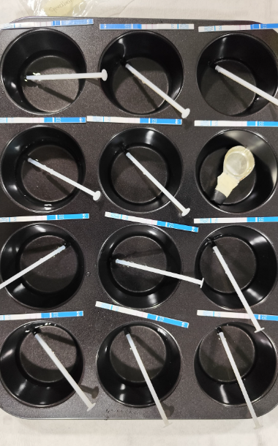
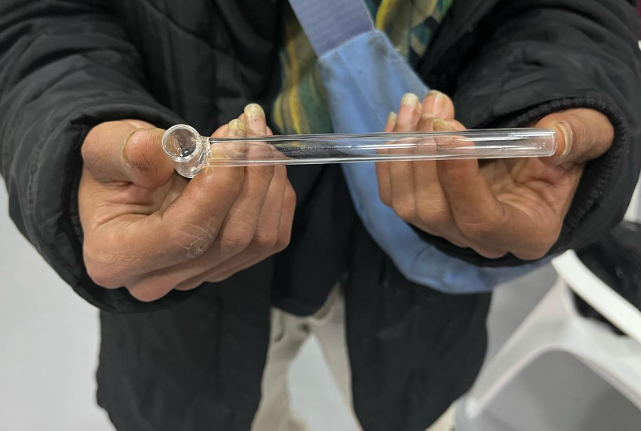
There are 83 registered users in Cambie.
We have provided +164 doses of naloxone to users and support networks.
We recently started the first small pilot to deliver pipes for smoking heroin.
We have monitored the market and analyzed heroin (+230 test) with fentanyl identification strips, the result was 100% negative.

Slide 15
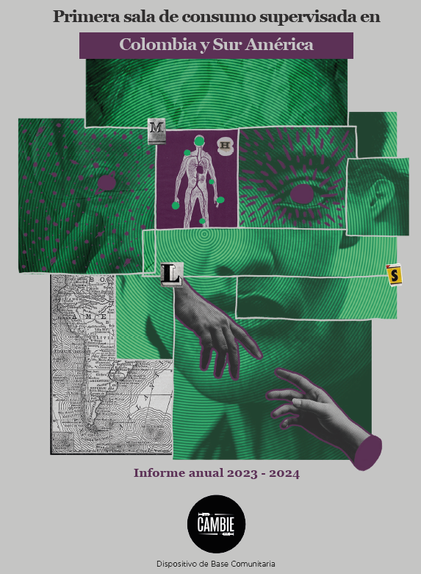
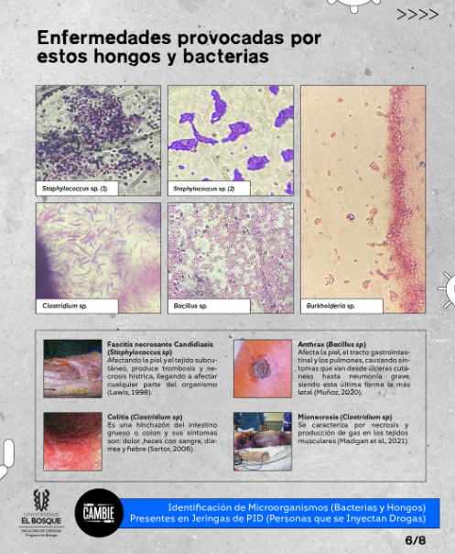
Research and evidence generation

Slide 16
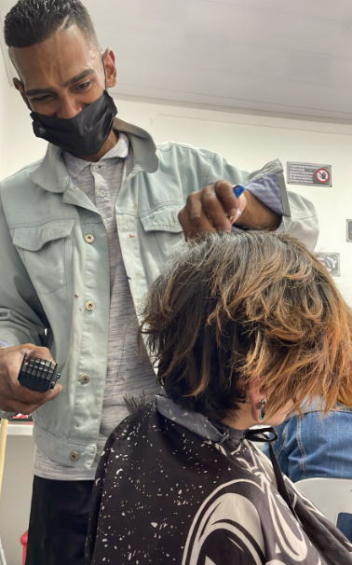
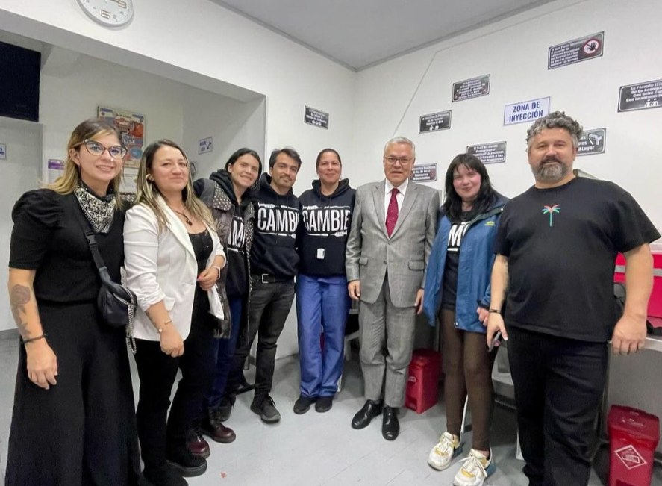
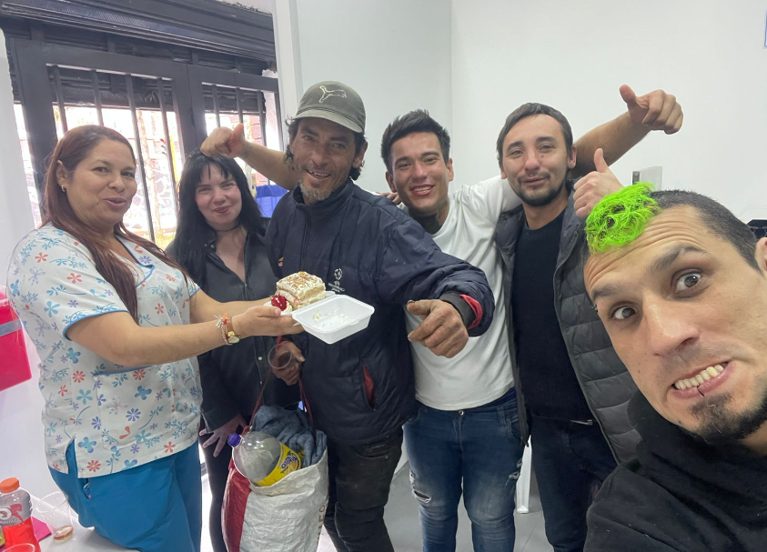
Skill enhancement and job search for users.
Communication and good relationship with the general community, pedagogy in changing the narrative.
Continuous team training (exchange of international experiences).
Management and adaptation of waves of violence focused on heroin users.
Advising the government on the creation of technical guidelines for the creation of supervised consumption rooms.

Slide 17
Future challenges
Regulation and standards that are easy to implement for the benefit of the territories.
Public resources that generate support for the SCS.
Development of integrated space, which includes use by smoking.
Approval for the use of oxygen in our facility and ambulances availability.
Maintaining adherence.
Articulation to generate access to methadone and antiretroviral treatment.
safe supply.

Slide 18
Thanks.

